Slide 1
Game jam project: The garden warrior

Slide 2
agenda
Introduction
Game design
Visual aids
What we learnt in the process

Slide 3
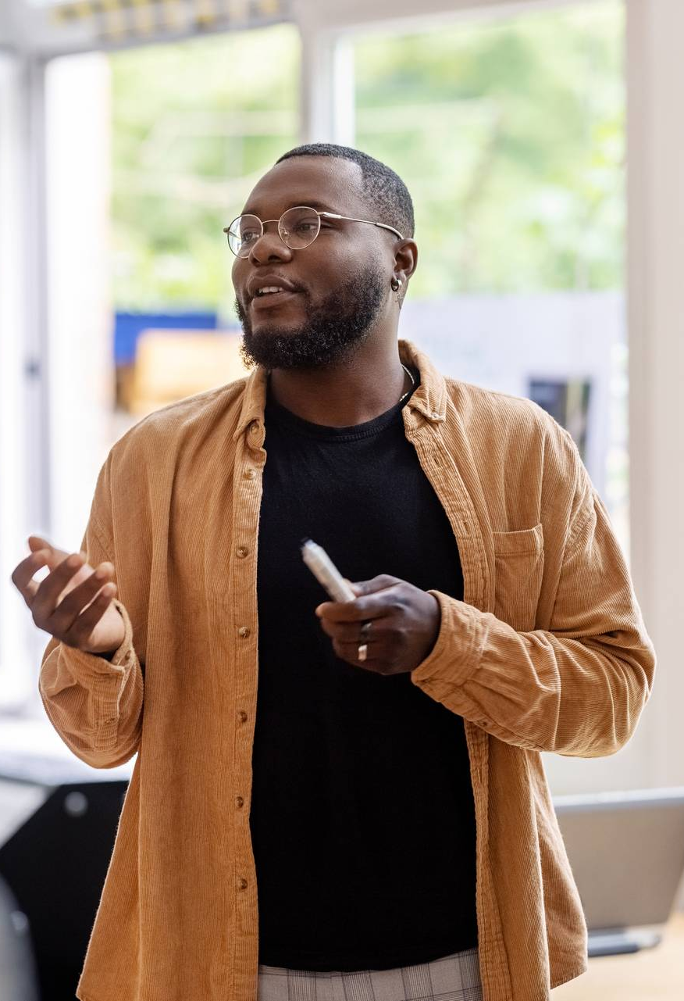
Ladies and gentlemen, I am excited to present to you a thrilling new game that we have been tirelessly working on. This game takes you on a journey through a medieval world where you play the role of a brave knight

Slide 4
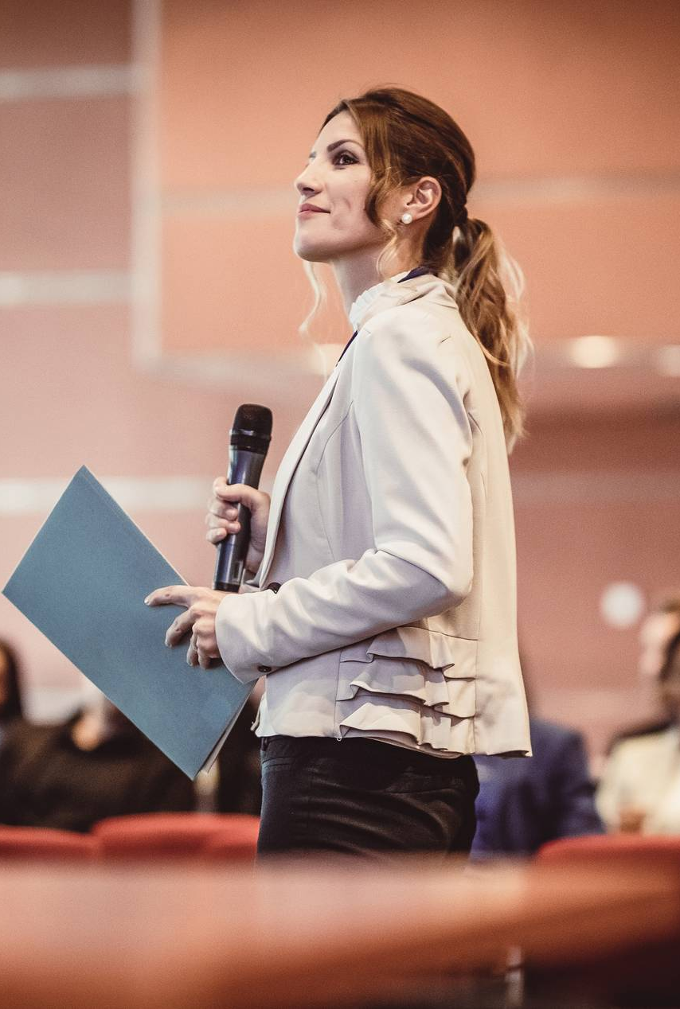
For the game jam project
We used unity engine , our aim was to make a 2d game in which the player enters a room and he gets to choose whether to upgrade his stats or remain the way he is. However, there is a cache here , if you increase one stat the other decreases. Thereby incorporating the sacrifice part of the theme.

Slide 5
Beware ! The sword and armour are breakable so if the player takes enough damage he dies. The goal is to survive as long as posssible
.

Slide 6
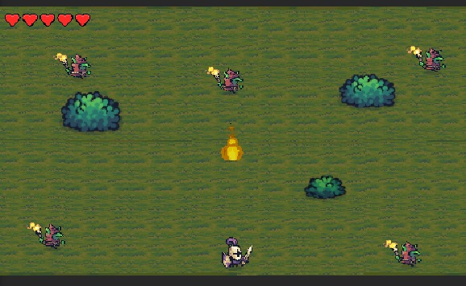
Credits: Aditya rout, bidyendu das, arpan behera

Slide 7

What we learnt in the process
To make the game Fun we chose to add upgrades .
And to make and track upgrades we learnt about the scriptable objects in unity.
Also we wanted the armour and sword breakable so we added scripts to the game objects.

Slide 8
Effective delivery techniques
This is a powerful tool in public speaking. It involves varying pitch, tone, and volume to convey emotion, emphasize points, and maintain interest.
Pitch variation
Tone inflection
Volume control
Effective body language enhances your message, making it more impactful and memorable.
Meaningful eye contact
Purposeful gestures
Maintain good posture
Control your expressions

Slide 9
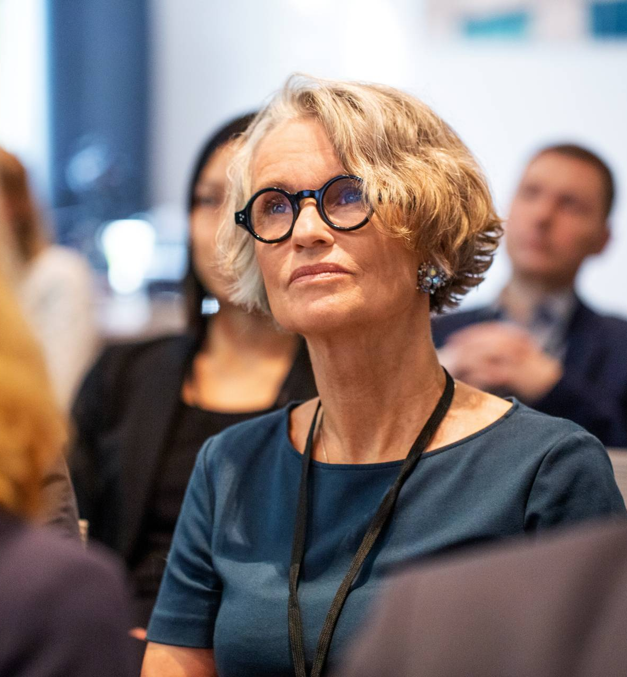
Speaking impact
Your ability to communicate effectively will leave a lasting impact on your audience
Effectively communicating involves not only delivering a message but also resonating with the experiences, values, and emotions of those listening

Slide 10
Learn to infuse energy into your delivery to leave a lasting impression
One of the goals of effective communication is to motivate your audience
 | # of attendees | 150 | 120
Engagement duration | Minutes | 60 | 75
Q&A interaction | # of questions | 10 | 15
Positive feedback | Percentage (%) | 90 | 95
Rate of information retention | Percentage (%) | 80

Slide 11
Final tips & takeaways
Consistent rehearsal
Strengthen your familiarity
Refine delivery style
Pacing, tone, and emphasis
Timing and transitions
Aim for seamless, professional delivery
Practice audience
Enlist colleagues to listen & provide feedback
Seek feedback
Reflect on performance
Explore new techniques
Set personal goals
Iterate and adapt

Slide 12
Speaking engagement metrics
Impact factor | Measurement | Target | Achieved
Audience interaction | Percentage (%) | 85 | 88
Knowledge retention | Percentage (%) | 75 | 80
Post-presentation surveys | Average rating | 4.2 | 4.5
Referral rate | Percentage (%) | 10 | 12
Collaboration opportunities | # of opportunities | 8 | 10

Slide 13
Thank you
Brita Tamm
502-555-0152
brita@firstupconsultants.com
www.firstupconsultants.com

